Slide 1
Yury Pushkarev Project 0 04/25/22 cohort

Slide 2
Table of contents
1
4
2
5
3
6
GIT
HTML
Links & Images
Tables & Lists
Block Elements & Inline Elements
SDLC
CSS
Scrum
Kanban
Box model
Flexbox
Custom properties
CSS Declarations and Selectors
WIREFRAMES
JAVASCRIPT
i. Call out to an external API
Notes:
I would like to talk about topics in the order they appear on project pdf itself

Slide 3
1
GIT
Notes:
Starting with GIT

Slide 4
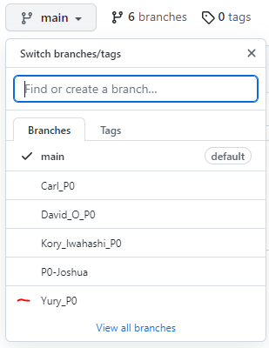
GIT
GIT
The associate squad should maintain a group GitHub repo that contains branches for their individual work.
Notes:
For our project we connected self-created branches to Salesforce main branch

Slide 5
2) Utilized= SDLC(Agile) frameworks +
SDLC Scrumban
Scrum
Kanban
=
+
Notes:
We also had utilized the combined Scrumban frame (combination of scrum and kanban

Slide 6
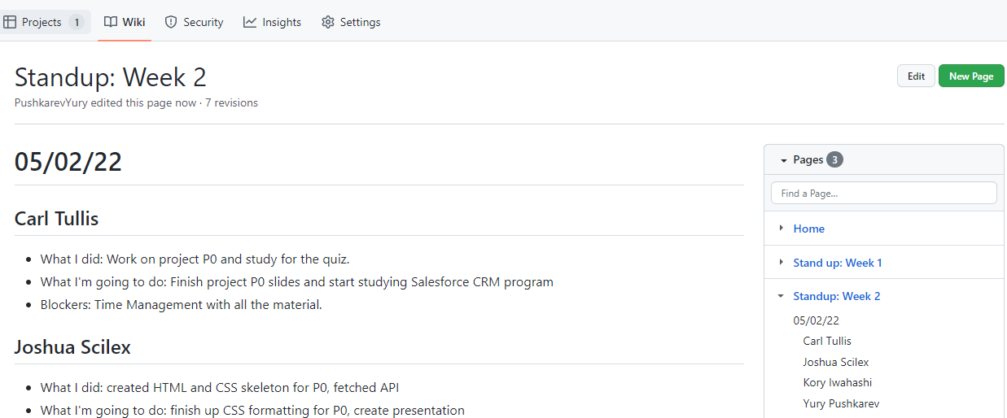
Scrum Ceremonies

Slide 7
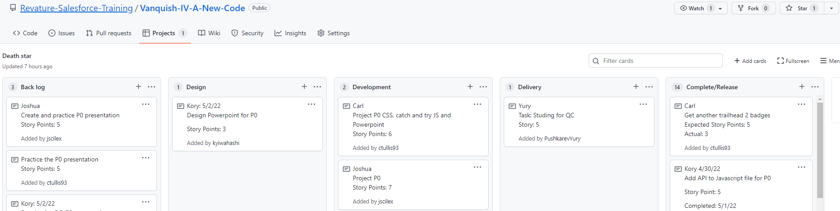
Kanban board
Notes:
We utilized Kanban boards to divided our work into individual stories stored in separate columns, which represented different SDLC phases

Slide 8

3 A wireframe is worth a thousand words

Slide 9
Wireframe
HTML
CSS
Javascript
Styling
Flexbox
Call out to API
Try {} catch () {}
Notes:
My website is divided into three distinct sections, with CSS and JS technologies connecting to the HTML to form a webpage…..And here is a preview

Slide 10
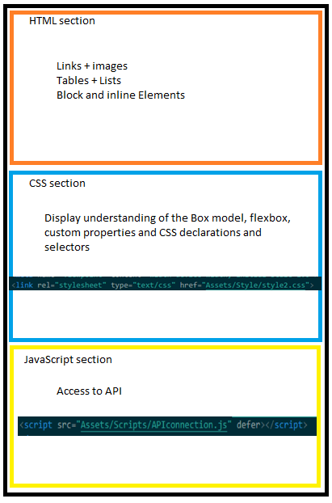
Notes:
Here is a visual

Slide 11
Remaining topics
HTML
Jaavascript
CSS
Closing slide
- Header
- Flexbox
Notes:
For the remaining time I want to talk about following topics, more specifically I found it difficult to visually present HTML Header and CSS Flexbox project requirements

Slide 12
HTML header – making website legal
 | First quarter
Title | <title> YuryP Project 0 - Salesforce </title>
Meta tags | <meta name="RevatureProject0" content="Week1demo"> <meta charset="uft-8"> <meta name="viewpoint" content="width=device-width, initial-scale=1.0">
Links | <link rel="stylesheet" type="text/css" href="Assets/Style/style2.css"> <script src="Assets/Scripts/APIconnection.js" defer></script>

Slide 13
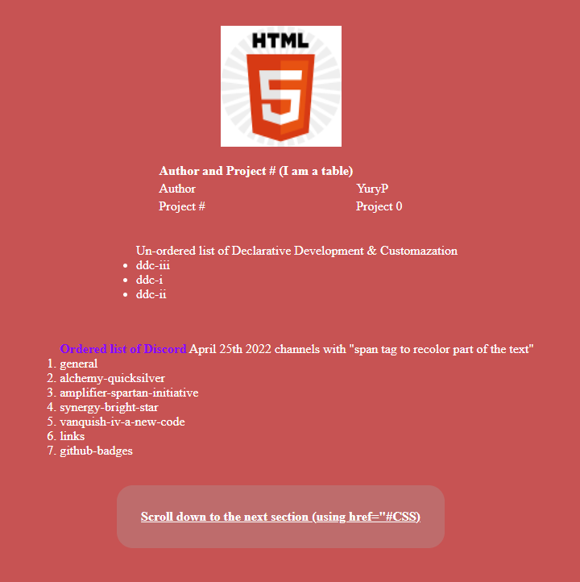

Flexbox
Notes:
Next is the flexbox and its importance for wide array of devices…everything on my website is centered as I would like it to appear on the phone.

Slide 14
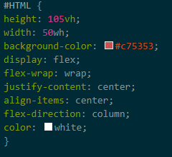
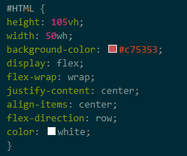
Flex-direction
Notes:
But changing just one value in CSS file from column to row will rearrange the website..

Slide 15
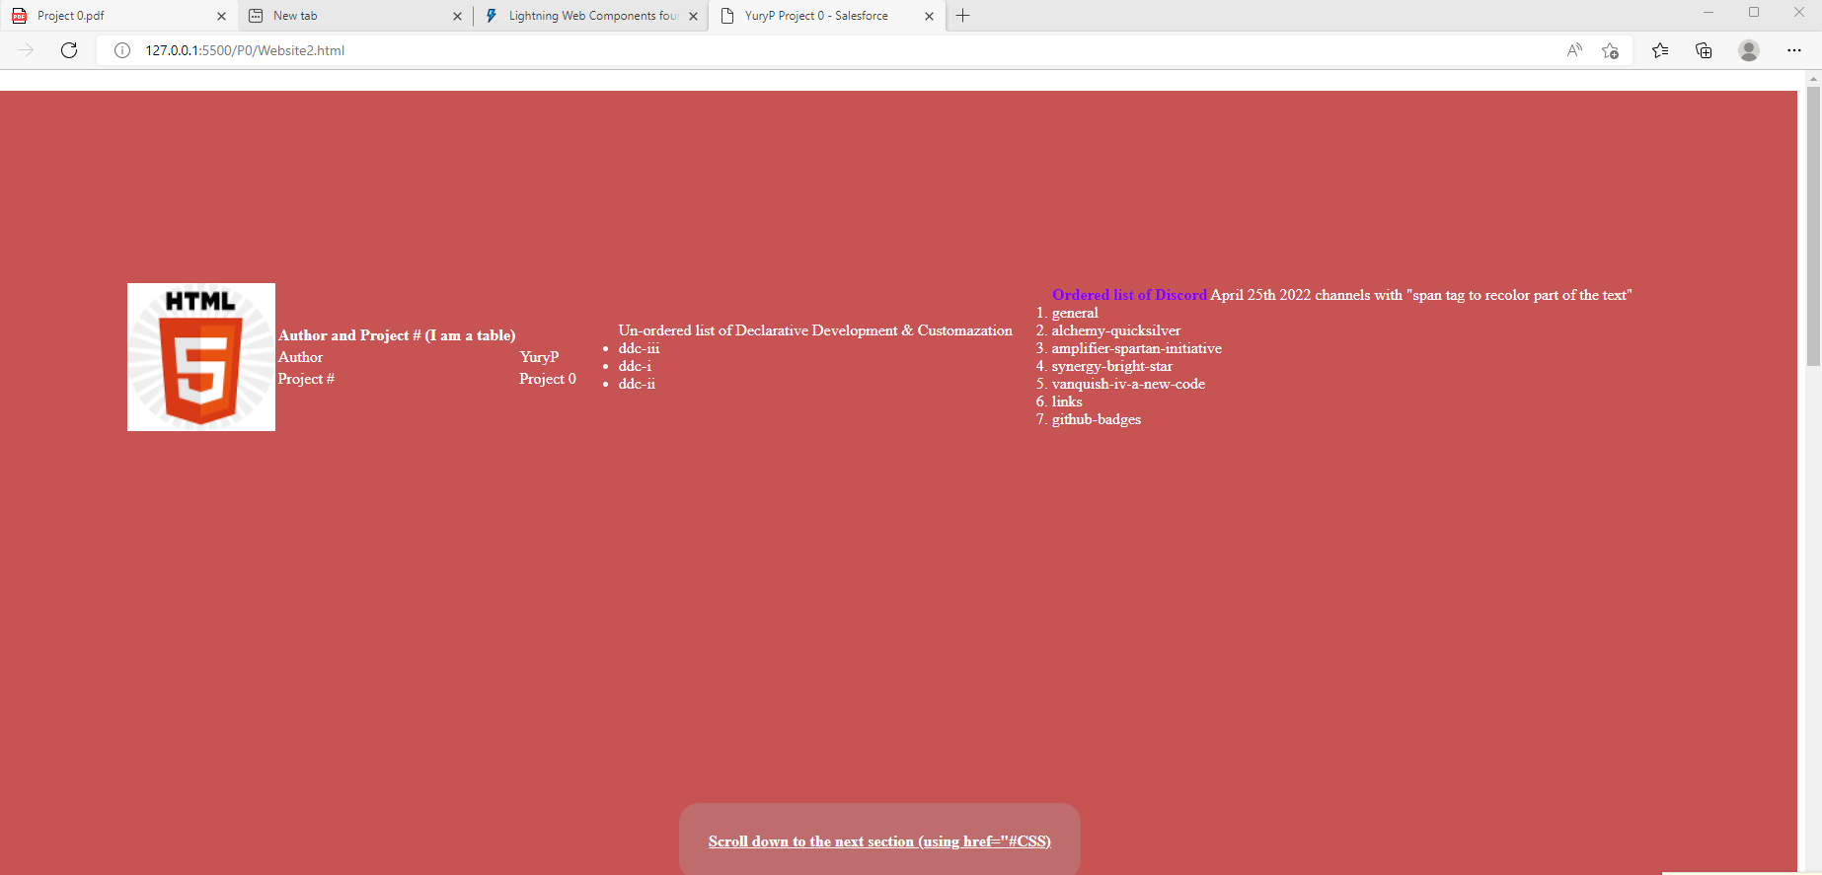
“Row” direction

Slide 16
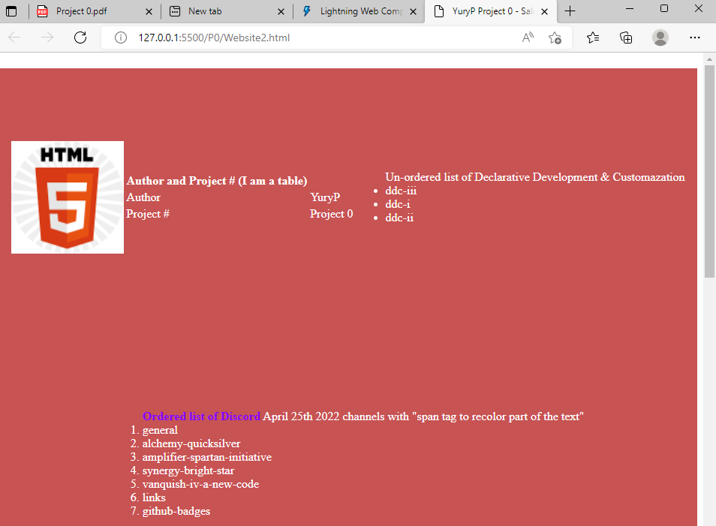

Slide 17
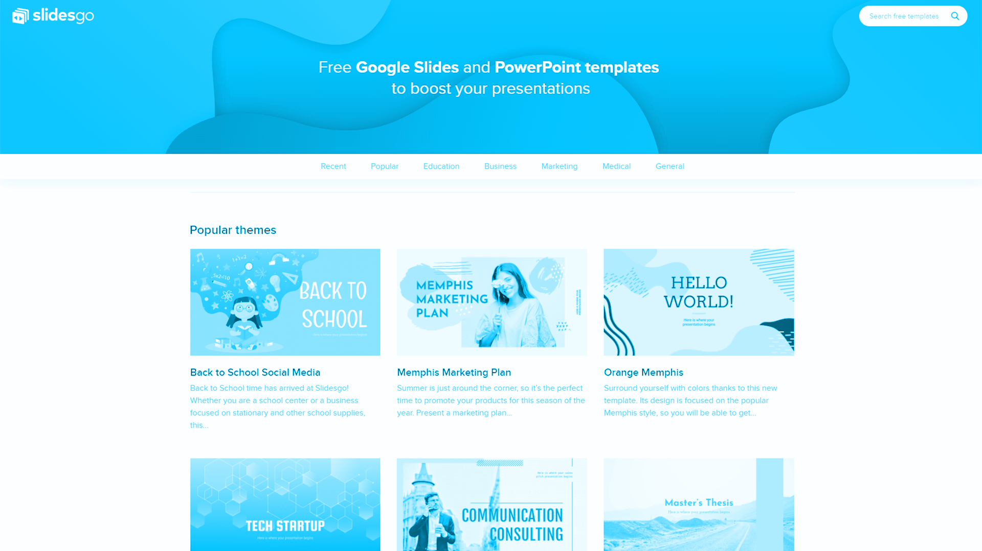
Website...

Slide 18
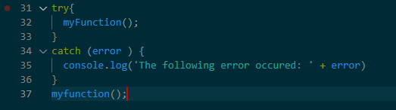
myFunction() (camelCase naming convention)

Slide 19

Thank you and have a good day
Do you have any questions?
yury840@revature.net

